Slide 1
Communication in Project Management
by
Marcin Ścioch
s3523@pjwstk.edu.pl

Slide 2
Instead of introduction
BOSS: We've got to get this application developed by the end of the week or you're all fired. Now, Jim, tell me what this means.
JIM: You're an idiot?
BOSS: No, you're fired. Sally?
SALLY: We've got to get this software developed by Friday or we'll be joining Jim at Wal-Mart.
BOSS: That's it. Get out. Get it done.

Slide 3
What does effective communication involves?
An exchange of information.
An act or instance of transmitting information.
A verbal or written message.
A technique for expressing ideas effectively.
A process by which meanings are exchanged between individuals through a common system of symbols.

Slide 4
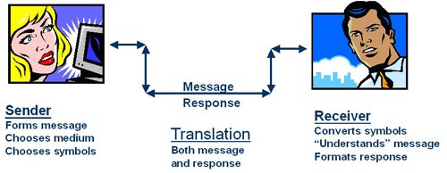

Slide 5
Project manager
is the person who has the overall responsibility for the successful planning and execution of project
has to come up with a plan of the flow of information and of the resources needed (servers etc)
is the one who’s responsible for making decisions both small and large

Slide 6
Project administrator
responsible for the deployment and maintenance of communication channels for the whole team
regular back-up of project data
provide timely response to inquiries from the team
allows a project member complete control over a project and speak on behalf of the project team

Slide 7
Types of communication
Formal
  In complex projects
Informal
  In small projects

Slide 8
A good and a bad message.
Who are you: | 723PC (Airplane tail number)
Where are you: | Dove Street (Location of where the plane is currently located)
Where are you going: | Mesa Departure (Will be traveling Over Costa Mesa) Santa Barbara (Final destination)
Local Weather Conditions: | Information Bravo (The FAA has an hourly local weather transmission that the pilot is required to have listened to prior to take-off)

Slide 9
A good and a bad message.
Who called: | 723PC (confirms who sent the message)
Confirmation on where: | Turn right heading 220 at or below 2400 (confirms the direction and altitude that the pilot can travel upon take-off.)
Next handoff: | Advisory Frequency 124.85 (pilot will pre-set the next transmission while in the air)
Transponder #: | Squawk 0210 (The transponder number that the air traffic controller has assigned to the plane and tracked on radar)

Slide 10
Written message
Sender and Receiver acknowledge each other
Few very specific words, explicit and unambiguous
Re-Affirm what has been heard and understood

Slide 11
Verbal message
The message itself
Para lingual attributes of the message
Nonverbal communication

Slide 12
Phone call
Quick - not more than 5 minutes
Professional
Point to point

Slide 13
References
Z. Szyjewski „Metody zarządzania projektami informatycznymi” Placet 2004
A. Mehta „Communication in Project Management”
www.informit.com

Slide 14
Thank you for your attention!

